Slide 1
ML Hackathon 2022:
Dataset Recommendation
By: TingTing Tsai, Lina Pav, Deborah Franza (HERkathon)

Slide 2
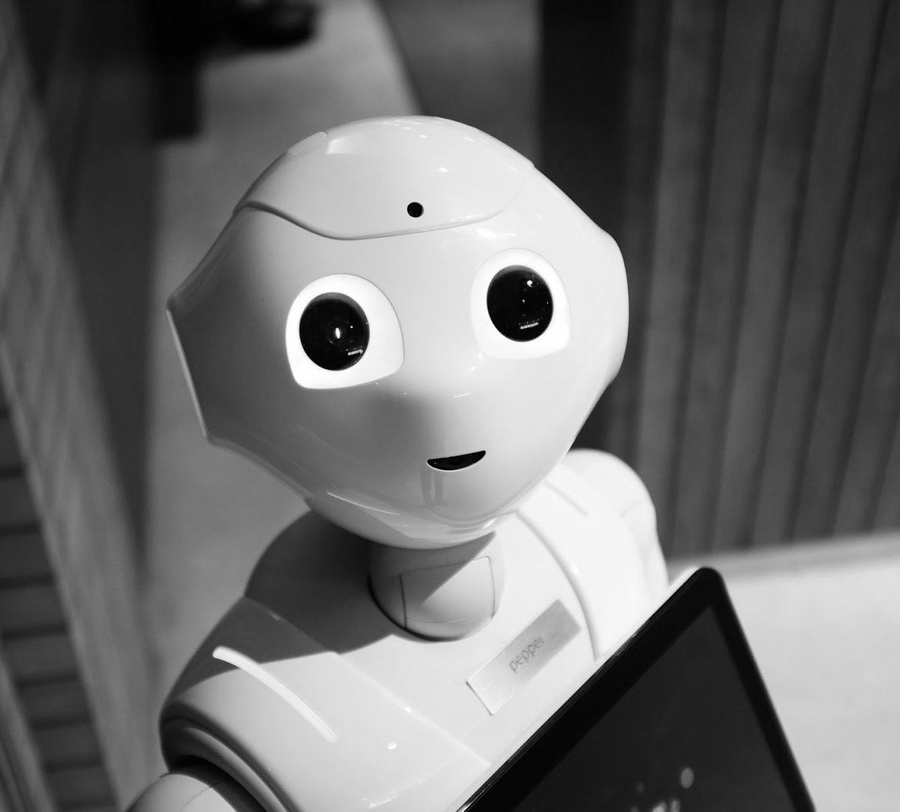
Presentation Overview:
What we did for the last 12 days
How we did it
How we would do it all over again/what we learned

Slide 3

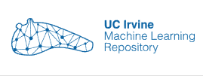


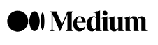






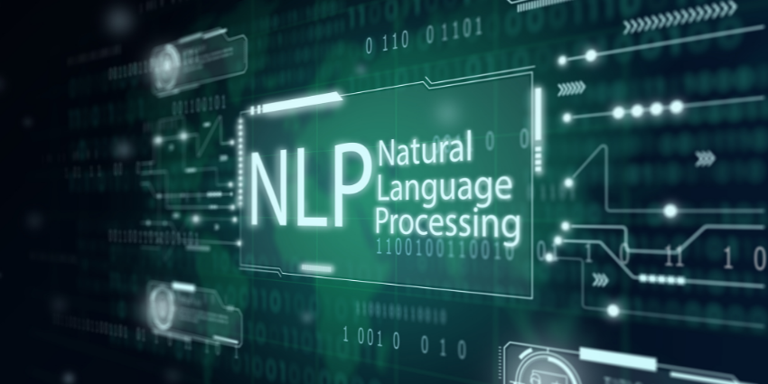


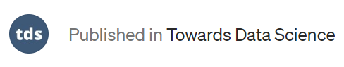
What We Did For The Last 12 Days:

Slide 4



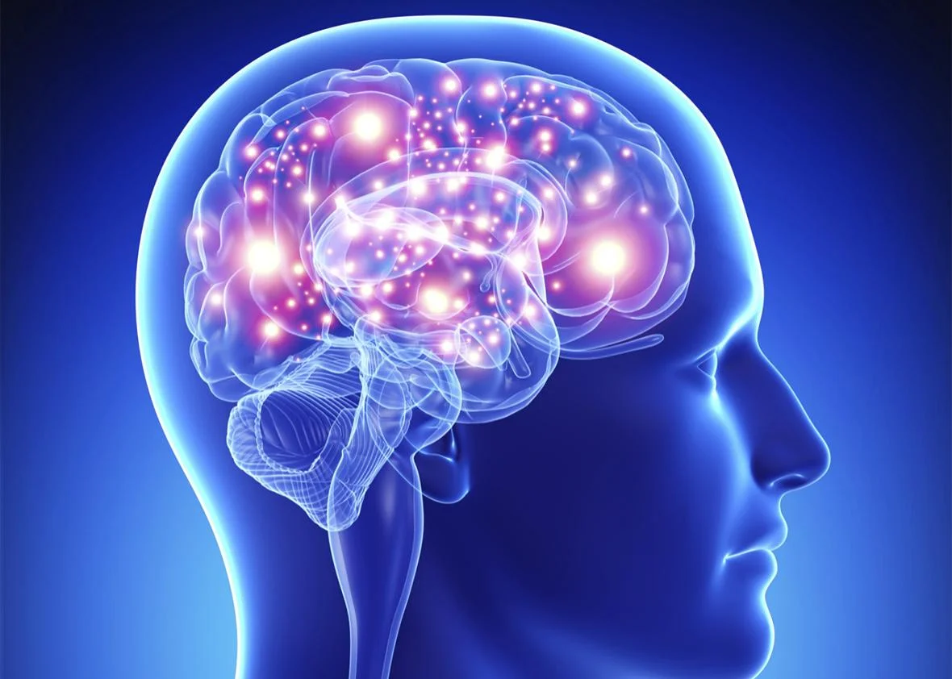
HERkathon Journey
HPC3
Papers With Code
NLP
Failed to work with HPC3
Gives us an intuitive/ inspiration
Encode both text and non-text
Google Colab
Discussion
Google Crash Course
Switch to Google Colab
Machine Learning Crash Course
Reached out to others for direction
Notes:
Trying to figure out where to start: Literature Review
Google Crashcourse
DS and ML Articles drove our discussions surround what is applicable to the data
Failed to work with HPC3 as a synchronous notebook
Switch to Google Colab
Tried to use papers with code to give us an intuitive/inspiration about what features for recommending datasets are good for UCI ML Repo
Determined that a classification model is best
Looked at finalist videos from last year
Outlined assumptions to test
Looked at the data: Reached out to others for direction
Reached to Tamanna
Reached to peers about working with the types of features we found (explosion function
Reached out to staff for suggestions
We processed the data
NLP
Encode both text and non-text into categories that can be used by a classification model
Applying Most Common Classification Models
Random first, naive Bayes, KNN Classifier
Figure out how to quantify the quality of the model, MSE didn’t make sense in this context

Slide 5
How We Did It:

Slide 6
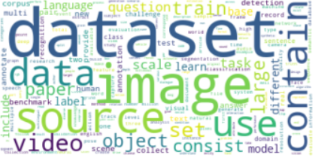
Data Exploration
Figuring out the number of unique values, types of each feature, etc.
Compare and contrast data from paperswithcode and UCI ML repository
Feature selection
Notes:
When we first started exploring the data we learned what functions we can use in Pandas to explore basic attributes of the data (data-types, number of unique terms, etc) while using basic python functions such as print().
Then we selected features based on our intuition, and choose what we think people normally look for when searching for the dataset and decided on language, paper titles, paper description, modalities, and dates.
Here is a word cloud of the most commonly used words throughout all descriptions and titles for all datasets included in out dataframe.

Slide 7
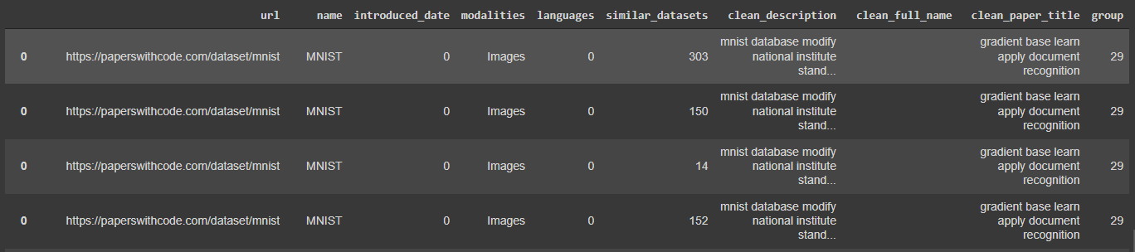
2. Data Preprocessing
Non-Text: Label Encoding & Target Encoding
Cleaning text by removing stopwords, lemmatizing tokens, etc.
Text Clustering
Before:
After:
Notes:
After exploring the dataset, we then preprocessed the dataset by dealing with the null values, deleted features we thought are not useful, etc.
For non text categorical features, we turn them into numerical values by implementing some encoding techniques like label encoding and target encoding.
For text features, we’ve applied some nlp techniques. We first clean them up by removing stopwords, puntuations, lemmatizing tokens, etc. Then we combine all of them into a huge text with different weights based on their importance before clustering them into groups. Finally we used the explode function to separate the list of similar datasets to be individual rows in the table.

Slide 8
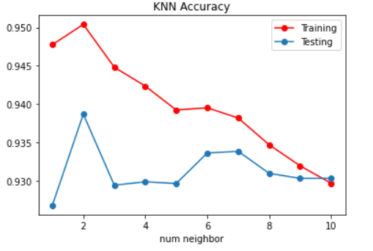
3. Training and Testing
Models:
Random Forest
Naive Bayes
KNN Classifier
Accuracy Calculation:
Training Features:
Introduced_date
Modalities
Languages
Group (keywords: description & paper_title)
Target: similar_dataset
Notes:
Once our data was cleaned up, we were able to start applying three of the most common classification models (Random Forest, Naive Bayes, KNN Classifier) to get results about how our well our 4 selected features did in predicted a single similar dataset given a dataset.
We discovered that for the KNN model we were able to optimize the prediction capability by determining the best value for the number-of-neighbors parameter that provided the highest prediction accuracy for our model.

Slide 9
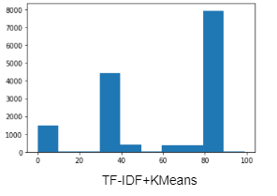
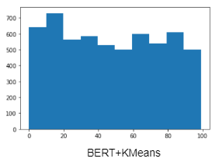
Analysis
TF-IDF (less complex) vs BERT (more complex)
High Probability?
Multiple similar dataset per row
Low criteria in calculating the number of similar dataset
 | Random Forest | Naive Bayes | KNN (neighbor=2)
TF-IDF | 0.979 | 0.982 | 0.978
BERT | 0.9281 | 0.905 | 0.9387
Notes:
Under BERT text clustering, KNN has better performance
Tfidf clustering: turns out that the probability is much higher than BERT because based on our own accuracy calculation, we mark correct similar prediction if the predict dataset match at least one feature to the actual dataset, and since kmeans is not distributed evenly, the similar_dataset for the prediction is more likely to match the actual similar_dataset, which brings up the probability of predicting correctly. However, it wouldn’t be a great clustering model because its complexity appears to be too low. So we decided to use BERT, which can potentially increase the complexity of our training model.
You may wonder why is the probability of our model getting the correct prediction is so high (93.033%)
Multiple right answers
No comparison to other models to gauge how well this model does relative to others
BERT has better clustering
How we quantified how well our models performed, then which clustering yielded the best results and then explaining why our accuracy is so high.
We’ve tried two different methods for text clustering, tf-idf vectorization with KMeans, and BERT Embedding with KMeans. BERT clustering turns out to be a better model than tfidf because it has higher complexity, though tfidf clustering has higher performance than BERT. The figures on the right showed how each text are spread out evenly among 100 cluster groups in BERT clustering compared to the tf-idf one.
For all three models We determined that the only way to sensibly quantify how our models were performing was to determine the percentage of predictions our models got right, dividing the correct number of predictions by the total number of predictions made.
You may wonder why the probability of our model getting the correct prediction is so high?
One of the reason is due to Multiple similar datasets per row.
Another reason is because there is no comparison to other models to gauge how well this model does relative to others

Slide 10
What We Learned
(And how we would do it all over again, knowing what we know now)

Slide 11
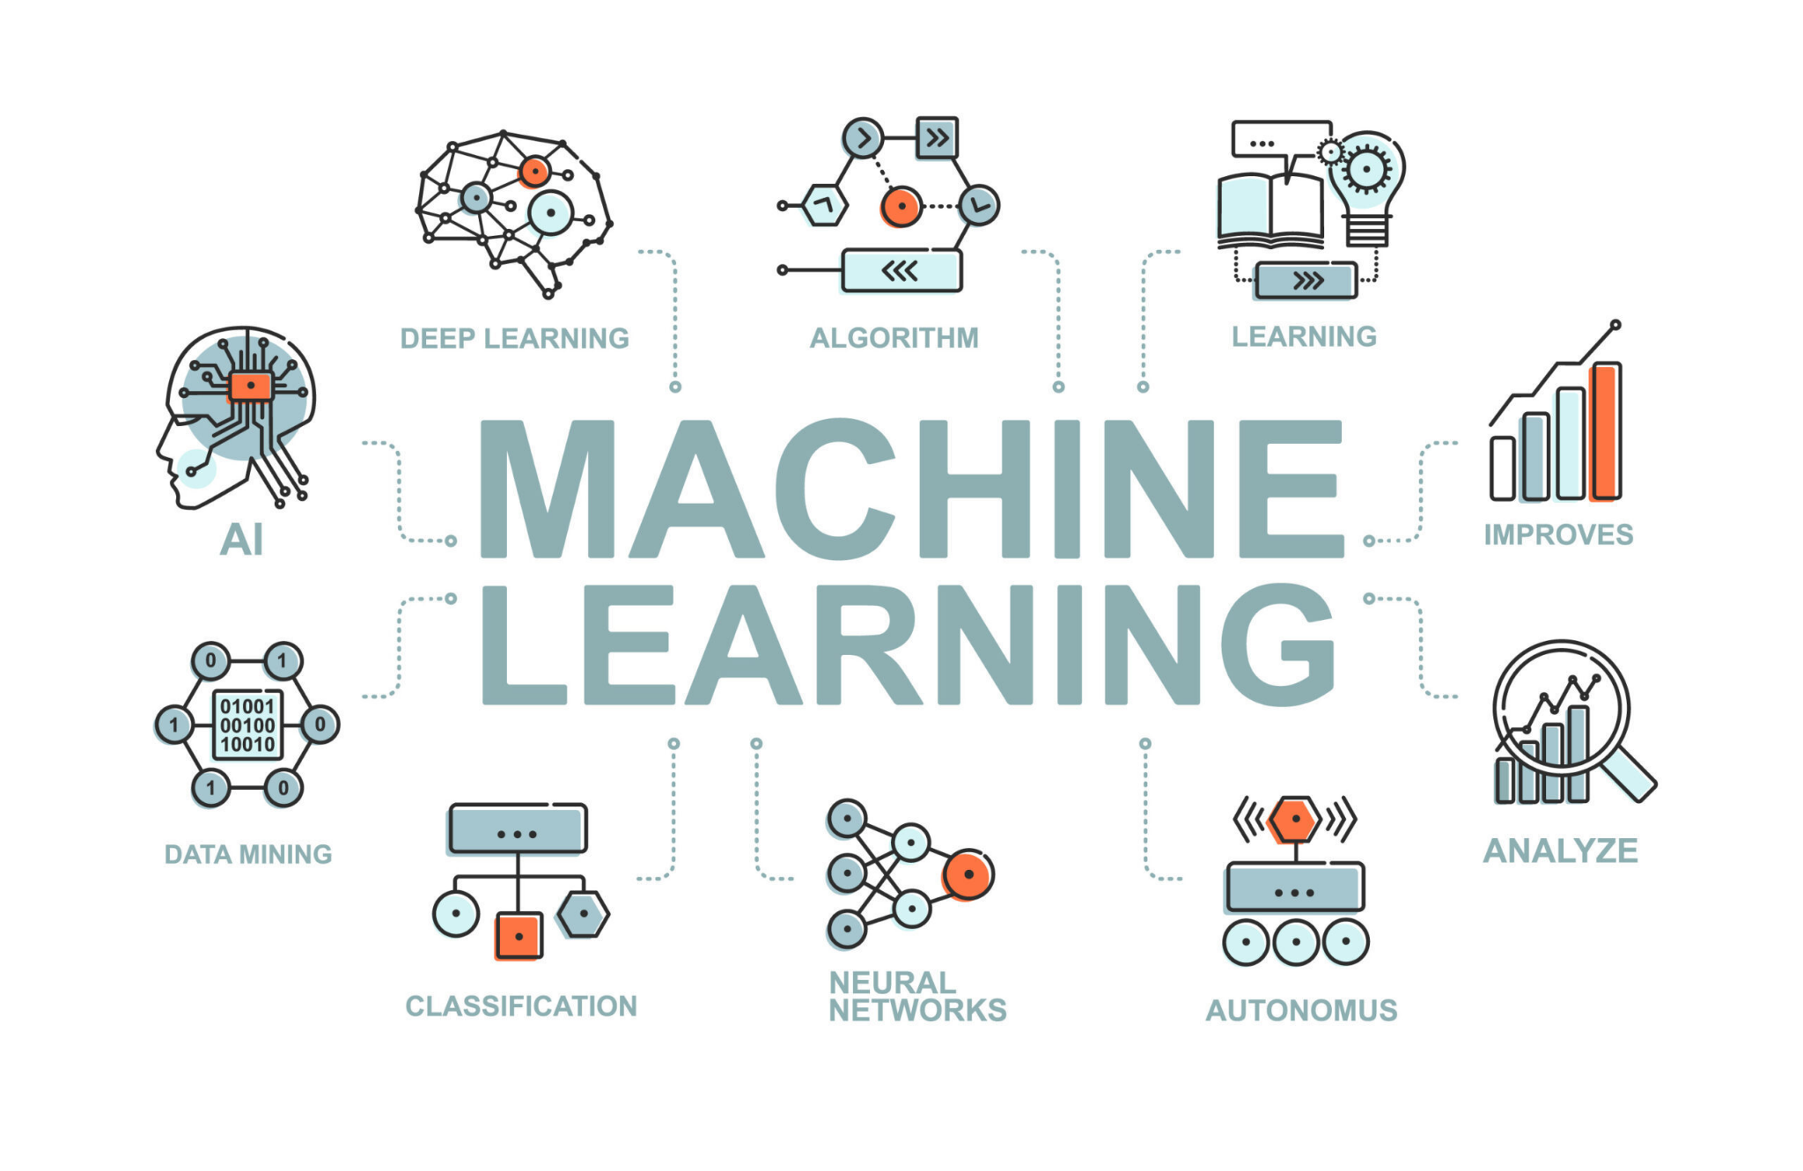
ML is a broad field with way more applications
Notes:
we started the hackathon with almost 0 knowledge in ML, and we quickly learned that ML is a very broad field that contains many models. It’s one of the fields that is important to predict the accuracy rate as well as human’s behavior. It’s really fascinating for me to see how we can use ML to break down our raw data set (using the NLP encoding) tekonized them and make keywords out of them.

Slide 12
01
02
03
04
Knowing types of data first
Visualizations go after preprocessing
Determining what assumptions to conduct hypothesis tests
Asking experienced Scientists or ML engineers for models to consider given the data
Notes:
Click

Slide 13
Thank You

